Slide 1



MSc thesis defense
Multilevel Multivariate Imputation by Chained Equations through Bayesian Additive Regression Trees
Heleen Brüggen
h.bruggen@students.uu.nl
Notes:
Introduce thesis:
- Multilevel MICE through BART
- BART --> non-parametirc sum-of-regression-trees model

Slide 2
Multilevel multiple imputation
Complexity
Congeniality
Notes:
Multilevel multiple imputation:
- Need to define imputation models for every variable that contains missing values
Complexity:
- hierarchical structure of data ---> need to account for this in the imputation models
- complex imputation models (hard to correctly specify, as well as might not converge)
Congeniality:
- the imputation model should be at least as general as the analysis model and preferably all-encompassing
---> otherwise not compatible
- The substantive model is not determined beforehand and step-wise
SEE IF BART CAN ALLEVIATE THESE COMPLEXITIES BY BEING NON-PARAMETRIC

Slide 3
Conclusion
The multilevel-BART method did not improve on the current implementation
Notes:
The current implementation of a multilevel-BART imputation method did not improve on the current implementation of multilevel predictive mean matching

Slide 4
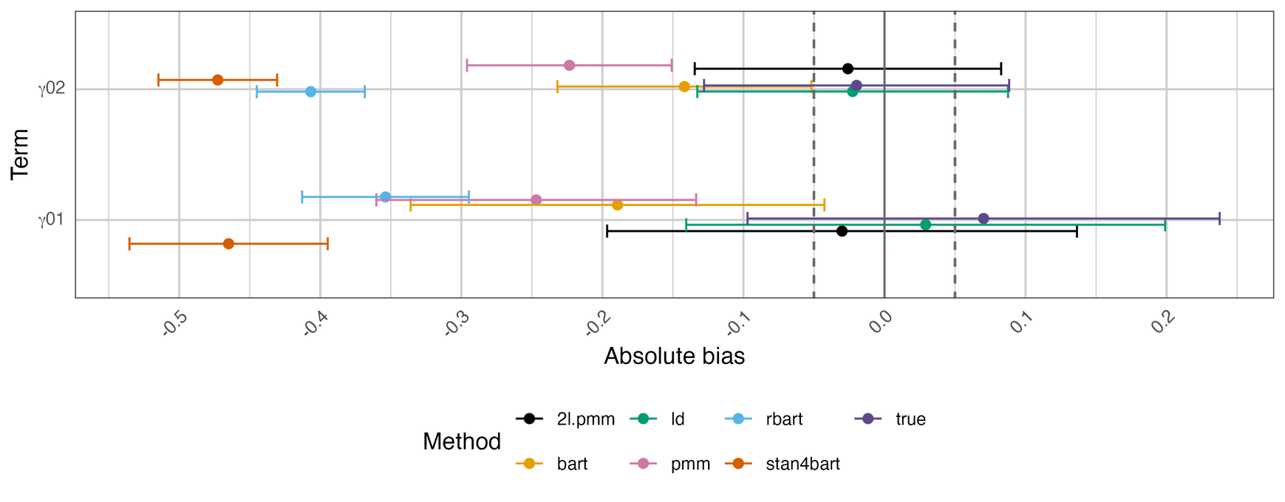
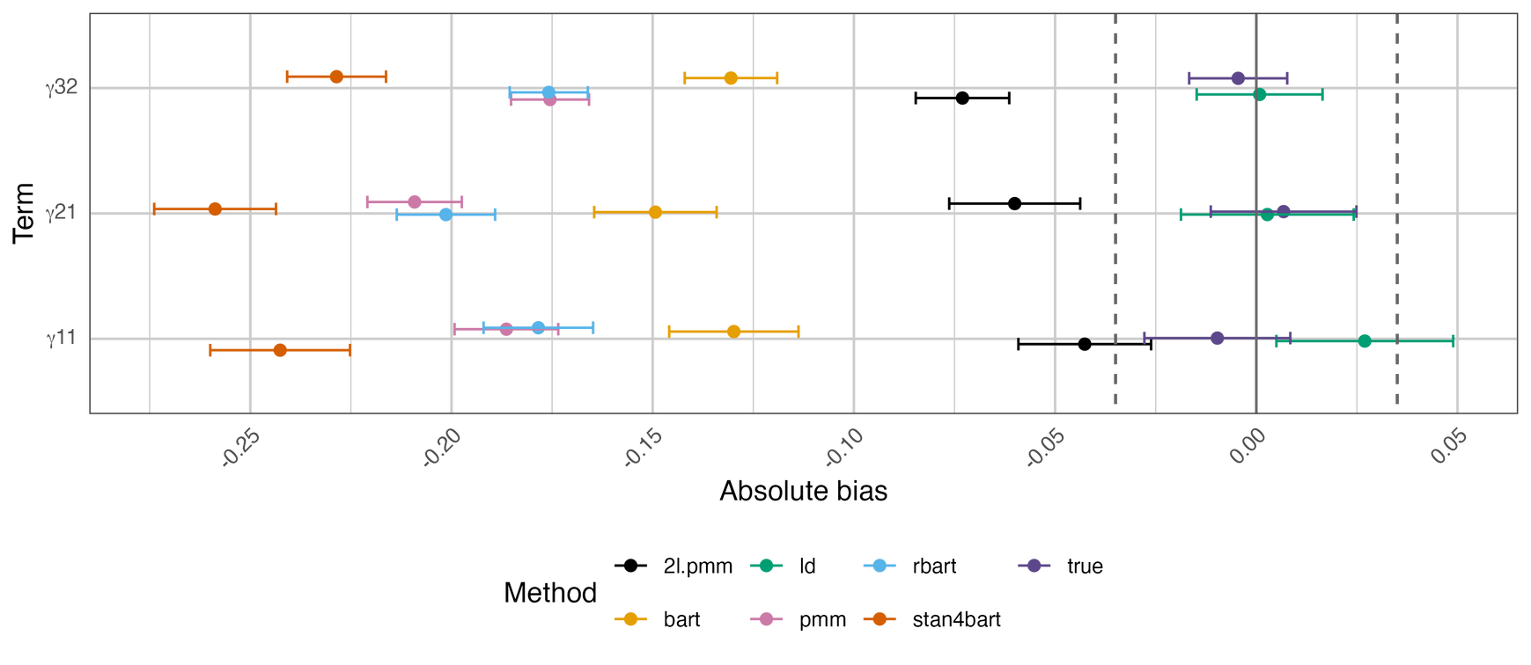
Results
Level-2 effects
Cross-level interactions
Notes:
Results
- Only absolute bias
- stan4bart = multilevel bart model
- 2l.pmm is conventional multilevel imputation
-
stan4bart does not outperform 2l.pmm in terms of level-2 effects
--> didn't contrain the imputation to be the same within group, thus estimating their variance incorrectly

Slide 5
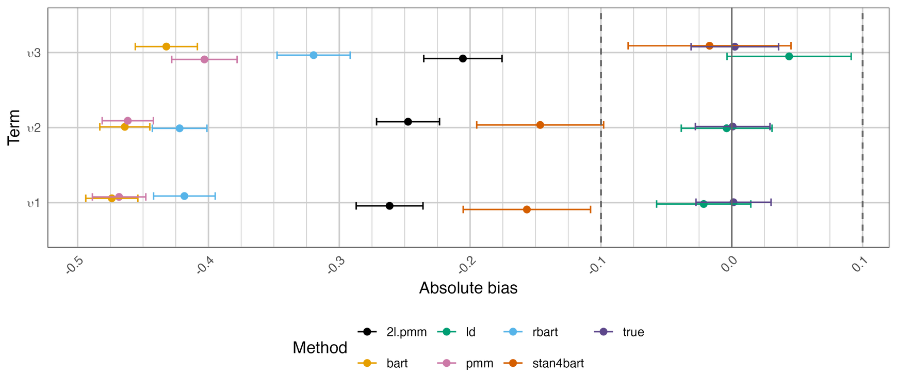
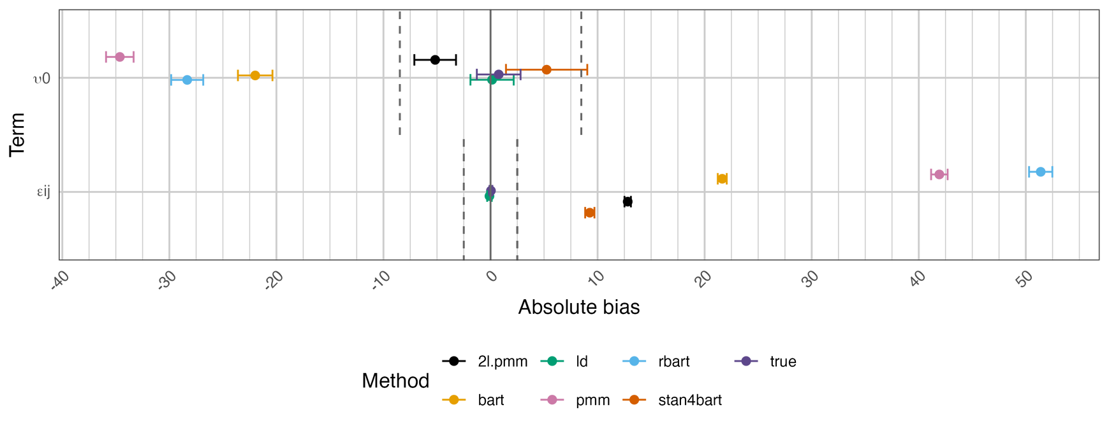
Results
Random slopes
Random intercept and residual variance
Notes:
stan4bart did outperform 2l.pmm in terms of random structure --> random intercept, slopes and residual variance

Slide 6
Method
1
2
3
4
Data generating mechanism
Simulation design
Missing data generation
Evaluation
Notes:
data generating mechanism:
- 7 level-2
- 2 level-2
- cross-level interactions
- random intercept
- 3 random slopes
- residual variance
simulation design:
- 30/50 groups
- 15/50 groupsize
- 0% or 50% missing
- MCAR or MAR
- .5 ICC
- 100 data sets
missing data generation:
- 50% --> 50% of people had one to 5 missing values
evaluation:
- absolute bias
- coverage
- confidence interval width

Slide 7
Limitations
Limited number of design factors
Amount of repetitions
MAR mechanism
Notes:
Limitations:
- Amount of repetitions: only 100 data sets --> 95% confidence interval coverage estimates are variable
- listwise deletion seemed to suggest a special case was generated --> methods were not evaluated with a strong MAR mechanism
- ICC was only .5, amount of missingness only 50%, and limited number of groups and their sizes

